Slide 1
Today’s Class
CS F212 Database Systems
E R Model to Relational Model

Slide 2
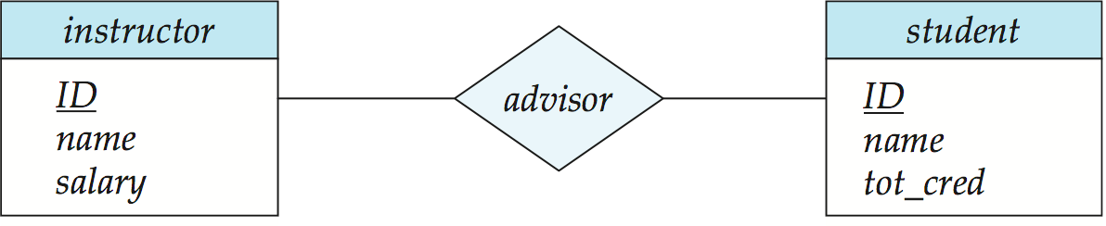
Representing Relationship Sets
A many-to-many relationship set is represented as a schema with attributes for the primary keys of the two participating entity sets, and any descriptive attributes of the relationship set.
Example: schema for relationship set advisor
advisor = (s_id, i_id)

Slide 3
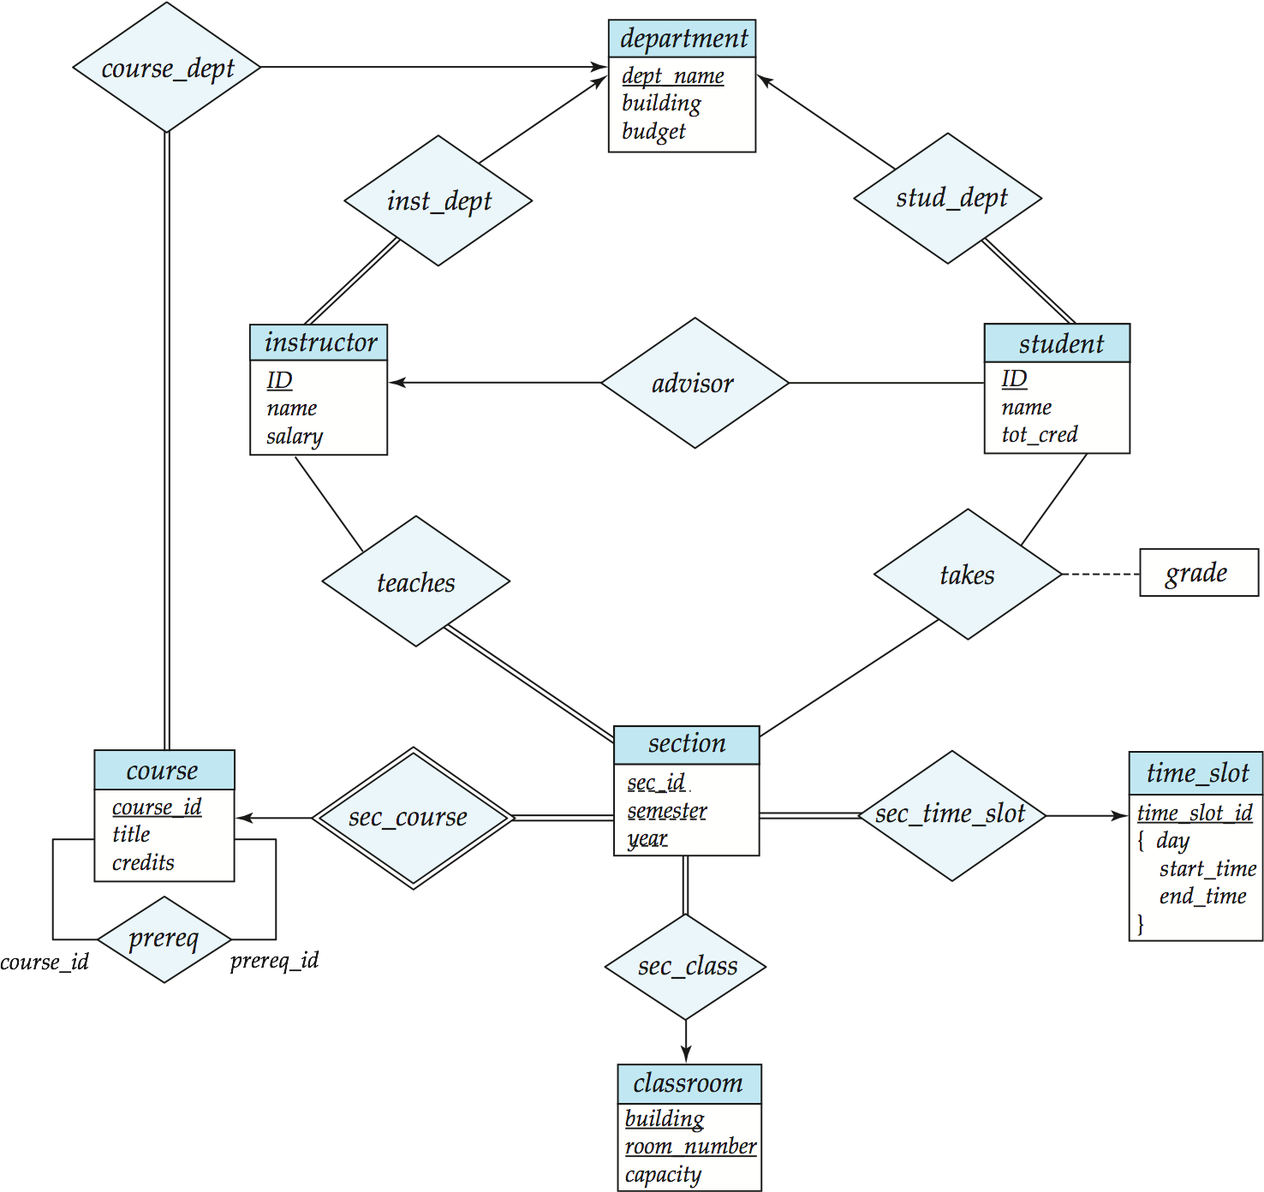
Redundancy of Schemas
Many-to-one and one-to-many relationship sets that are total on the many-side can be represented by adding an extra attribute to the “many” side, containing the primary key of the “one” side
Example: Instead of creating a schema for relationship set inst_dept, add an attribute dept_name to the schema arising from entity set instructor

Slide 4
Redundancy of Schemas
For one-to-one relationship sets, either side can be chosen to act as the “many” side
That is, extra attribute can be added to either of the tables corresponding to the two entity sets
If participation is partial on the “many” side, replacing a schema by an extra attribute in the schema corresponding to the “many” side could result in null values
The schema corresponding to a relationship set linking a weak entity set to its identifying strong entity set is redundant.
Example: The section schema already contains the attributes that would appear in the sec_course schema
Notes:
4

Slide 5
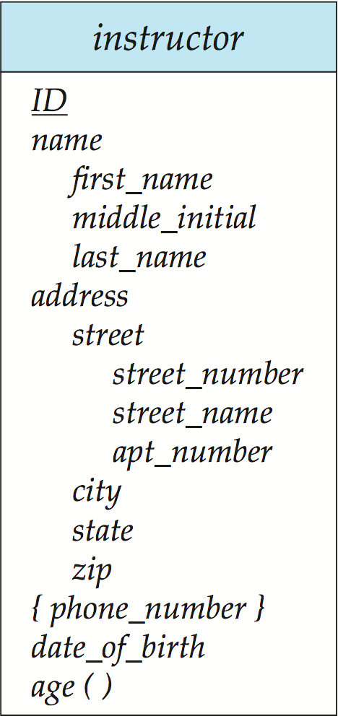
Composite and Multivalued Attributes
Composite attributes are flattened out by creating a separate attribute for each component attribute
Example: given entity set instructor with composite attribute name with component attributes first_name and last_name the schema corresponding to the entity set has two attributes name_first_name and name_last_name
Prefix omitted if there is no ambiguity
Ignoring multivalued attributes, extended instructor schema is
instructor(ID, first_name, middle_initial, last_name,street_number, street_name, apt_number, city, state, zip_code, date_of_birth)
Notes:
5

Slide 6
Composite and Multivalued Attributes
A multivalued attribute M of an entity E is represented by a separate schema EM
Schema EM has attributes corresponding to the primary key of E and an attribute corresponding to multivalued attribute M
Example: Multivalued attribute phone_number of instructor is represented by a schema: inst_phone= ( ID, phone_number)
Each value of the multivalued attribute maps to a separate tuple of the relation on schema EM
For example, an instructor entity with primary key 22222 and phone numbers 456-7890 and 123-4567 maps to two tuples: (22222, 456-7890) and (22222, 123-4567)
Notes:
6

Slide 7
Representing Composite Attribute
Relational Model Indivisibility Rule Applies
One column for each component attribute
NO column for the composite attribute itself
SSN
Name
SSN | Name | Street | City
9999 | Dr. Smith | 50 1st St. | Fake City
8888 | Dr. Lee | 1 B St. | San Jose
Professor
Address
Street
City

Slide 8
Representing Multivalue Attribute
For each multivalue attribute in an entity set/relationship set
Build a new relation schema with two columns
One column for the primary keys of the entity set/relationship set that has the multivalue attribute
Another column for the multivalue attributes. Each cell of this column holds only one value. So each value is represented as an unique tuple
Primary key for this schema is the union of all attributes

Slide 9
Example – Multivalue attribute
SID
Name
The primary key for this table is Student_SID + Children, the union of all attributes
Children
Student
Major
GPA
Stud_SID | Children
1234 | Johnson
1234 | Mary
5678 | Bart
5678 | Lisa
5678 | Maggie
SID | Name | Major | GPA
1234 | John | CS | 2.8
5678 | Homer | EE | 3.6

Slide 10
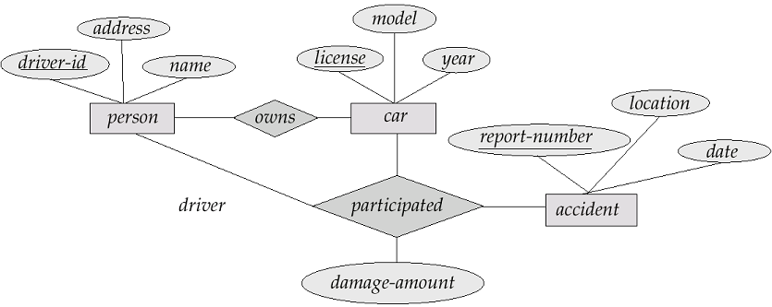

Slide 12
A movie studio might have several film crews. The crews might be designated by a given studio as crew 1, crew 2, and so on. However, other studios might use the same designations for crews, so the attribute number is not a key for crews. Rather, to name a crew uniquely, we need to give both the name of the studio to which it belongs and the number of crew. The key for the weak entity set Crews is its own number attribute and the name attribute of the unique studio to which the crew is related by the many-one Unit-of relationship.

Slide 13
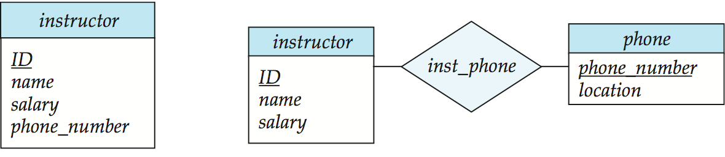
Design Issues
Use of entity sets vs. attributes
Use of phone as an entity allows extra information about phone numbers (plus multiple phone numbers)
Notes:
13

Slide 14
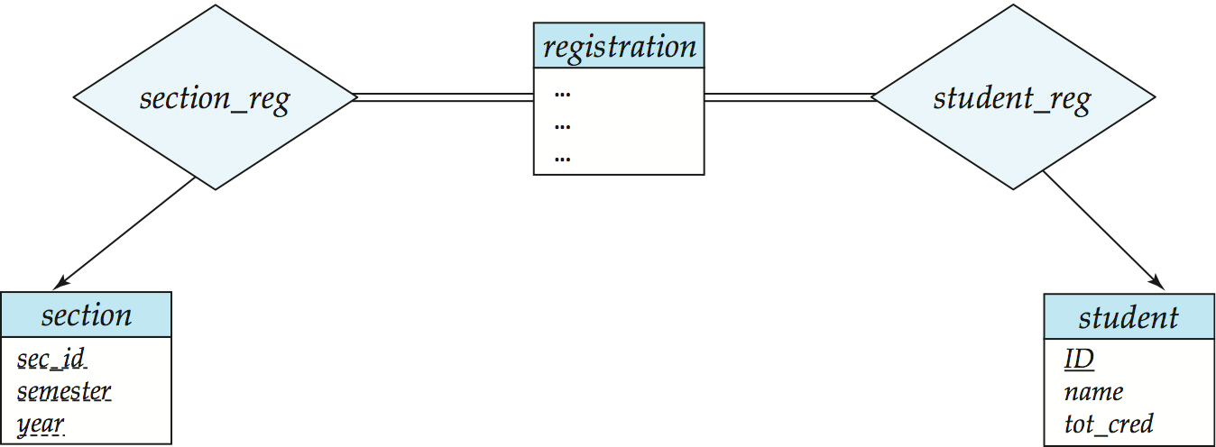
Design Issues
Use of entity sets vs. relationship sets Possible guideline is to designate a relationship set to describe an action that occurs between entities
Notes:
14

Slide 15
Design Issues
Binary versus n-ary relationship sets Although it is possible to replace any nonbinary (n-ary, for n > 2) relationship set by a number of distinct binary relationship sets, a n-ary relationship set shows more clearly that several entities participate in a single relationship.
Placement of relationship attributes
e.g., attribute date as attribute of advisor or as attribute of student
Notes:
15

Slide 16
Representing Relationship Set N-ary Relationship
Intuitively Simple
Build a new table with as many columns as there are attributes for the union of the primary keys of all participating entity sets.
Augment additional columns for descriptive attributes of the relationship set (if necessary)
The primary key of this table is the union of all primary keys of entity sets that are on “many” side
That is it, we are done.

Slide 17
Example – N-ary Relationship Set
P-Key1
D-Attribute
A-Key
E-Set 1
P-Key2
A relationship
Another Set
E-Set 2
P-Key3
E-Set 3
P-Key1 | P-Key2 | P-Key3 | A-Key | D-Attribute
9999 | 8888 | 7777 | 6666 | Yes
1234 | 5678 | 9012 | 3456 | No
* Primary key of this table is P-Key1 + P-Key2 + P-Key3

Slide 18
Relationship Example
since
name
dname
psrn
dob
did
budget
Employees
Works_In
Departments
Notes:
4

Slide 19
Relationship Sets to Tables
In translating a relationship set to a relation, attributes of the relation must include:
Keys for each participating entity set (as foreign keys).
All descriptive attributes.
CREATE TABLE Works_In(
psrn INTEGER,
did INTEGER,
since DATE,
PRIMARY KEY (psrn, did),
FOREIGN KEY (psrn)
REFERENCES Employees,
FOREIGN KEY (did)
REFERENCES Departments)
Notes:
5

Slide 20
Weak Entities
A weak entity can be identified uniquely only by considering the primary key of another (owner) entity.
Owner entity set and weak entity set must participate in a one-to-many relationship set (one owner, many weak entities).
Weak entity set must have total participation in this identifying relationship set.
name
psrn
dept
cost
pname
age
Employees
Policy
Dependents
Notes:
10

Slide 21
Translating Weak Entity Sets
Weak entity set and identifying relationship set are translated into a single table.
When the owner entity is deleted, all owned weak entities must also be deleted.
CREATE TABLE Dep_Policy (
pname CHAR(20),
age INTEGER,
cost REAL,
psrn INTEGER NOT NULL,
PRIMARY KEY (pname, ssn),
FOREIGN KEY (psrn) REFERENCES Employees,
ON DELETE CASCADE)
Notes:
11

Slide 22
Review: Key Constraints
Each dept has at most one manager, according to the key constraint on Manages.
since
name
dname
ssn
lot
did
budget
Employees
Manages
Departments
Translation to
relational model?
1-to-1
1-to Many
Many-to-1
Many-to-Many
Notes:
6

Slide 23
Translating ER Diagrams with Key Constraints
CREATE TABLE Manages(
ssn CHAR(11),
did INTEGER,
since DATE,
PRIMARY KEY (did),
FOREIGN KEY (ssn) REFERENCES Employees,
FOREIGN KEY (did) REFERENCES Departments)
Map relationship to a table:
Note that did is the key now!
Separate tables for Employees and Departments.
Since each department has a unique manager, we could instead combine Manages and Departments.
CREATE TABLE Dept_Mgr(
did INTEGER,
dname CHAR(20),
budget REAL,
ssn CHAR(11),
since DATE,
PRIMARY KEY (did),
FOREIGN KEY (ssn) REFERENCES Employees)
Notes:
7

Slide 24
Review: Participation Constraints
Does every department have a manager?
If so, this is a participation constraint: the participation of Departments in Manages is said to be total (vs. partial).
CREATE TABLE Dept_Mgr(
did INTEGER,
dname CHAR(20),
budget REAL,
ssn CHAR(11) NOT NULL,
since DATE,
PRIMARY KEY (did),
FOREIGN KEY (ssn) REFERENCES Employees,
ON DELETE NO ACTION)
Notes:
8

Slide 25
Review: ISA Hierarchies
If we declare A ISA B, every A entity is also considered to be a B entity.
name
ssn
lot
Employees
hourly_wages
hours_worked
ISA
contractid
Hourly_Emps
Contract_Emps
Overlap constraints: Can Joe be an Hourly_Emps as well as a Contract_Emps entity? (Allowed/disallowed)
Covering constraints: Does every Employees entity also have to be an Hourly_Emps or a Contract_Emps entity? (Yes/no)
Notes:
12

Slide 26
Translating ISA Hierarchies to Relations
General approach:
3 relations: Employees, Hourly_Emps and Contract_Emps.
Hourly_Emps: Every employee is recorded in Employees. For hourly emps, extra info recorded in Hourly_Emps (hourly_wages, hours_worked, ssn); must delete Hourly_Emps tuple if referenced Employees tuple is deleted).
Queries involving all employees easy, those involving just Hourly_Emps require a join to get some attributes.
Alternative: Just Hourly_Emps and Contract_Emps.
Hourly_Emps: ssn, name, lot, hourly_wages, hours_worked.
Each employee must be in one of these two subclasses.
Notes:
13

Slide 27
Representing Class Hierarchy
Two general approaches depending on disjointness and completeness
For non-disjoint and/or non-complete class hierarchy:
create a table for each super class entity set according to normal entity set translation method.
Create a table for each subclass entity set with a column for each of the attributes of that entity set plus one for each attributes of the primary key of the super class entity set
This primary key from super class entity set is also used as the primary key for this new table

Slide 28
Example
SSN
Name
Person
SID
Status
Gender
ISA
Student
Major
GPA
SSN | Name | Gender
1234 | Homer | Male
5678 | Marge | Female
SSN | SID | Status | Major | GPA
1234 | 9999 | Full | CS | 2.8
5678 | 8888 | Part | EE | 3.6

Slide 29
Representing Class Hierarchy
Two general approaches depending on disjointness and completeness
For disjoint AND complete mapping class hierarchy:
DO NOT create a table for the super class entity set
Create a table for each subclass entity set include all attributes of that subclass entity set and attributes of the superclass entity set
Simple and Intuitive enough, need example?

Slide 30
Example
SSN
Name
No table created for superclass entity set
SJSU people
ISA
SID
Student
Faculty
Disjoint and Complete mapping
Major
GPA
Dept
SSN | Name | SID | Major | GPA
1234 | John | 9999 | CS | 2.8
5678 | Mary | 8888 | EE | 3.6
SSN | Name | Dept
1234 | Homer | C.S.
5678 | Marge | Math

Slide 31
Representing Aggregation
Name
SSN
Name
Student
Advisor
Professor
Dept
SID
Name
member
Primary Key of Advisor
Dept
SID | Code
1234 | 04
5678 | 08
Code
Primary key of Dept

Slide 32
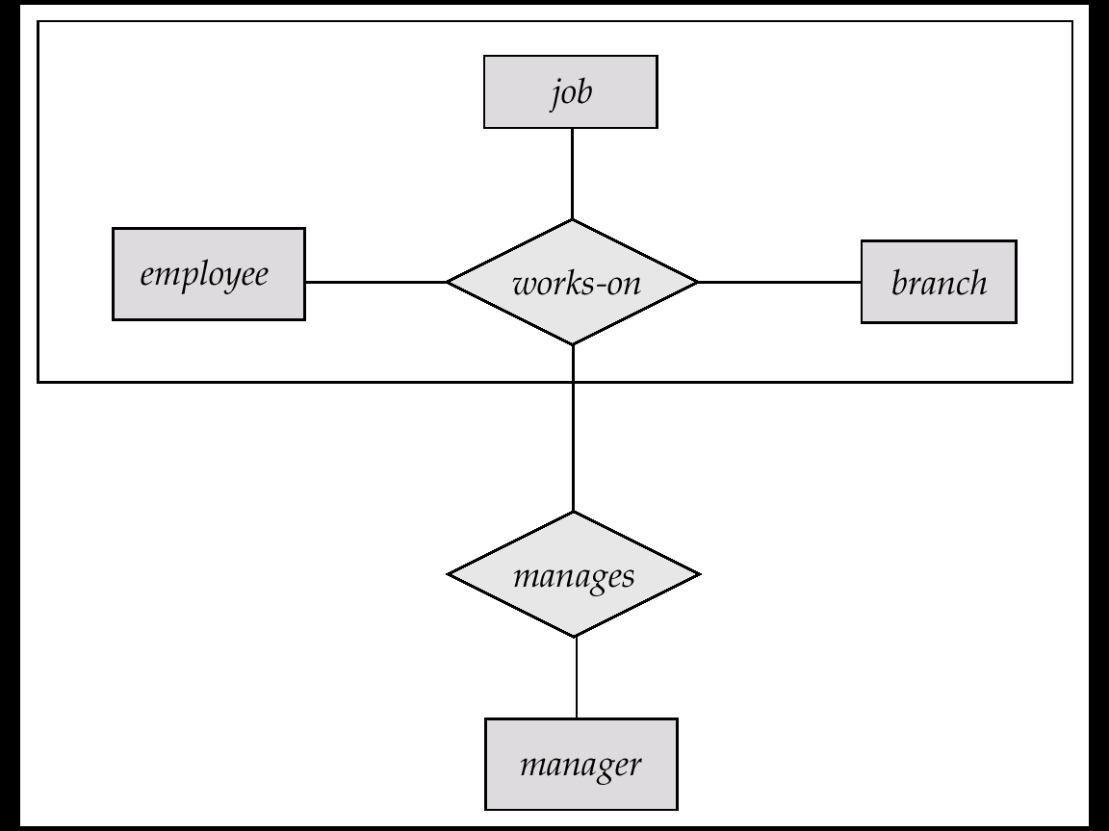
Schemas Corresponding to Aggregation
For example, to represent aggregation manages between relationship works_on and entity set manager, create a schema manages (employee_id, branch_name, title, manager_name)

Slide 33
Binary Vs. Non-Binary Relationships
Some relationships that appear to be non-binary may be better represented using binary relationships
E.g., A ternary relationship parents, relating a child to his/her father and mother, is best replaced by two binary relationships, father and mother
Using two binary relationships allows partial information (e.g., only mother being know)
But there are some relationships that are naturally non-binary
Example: proj_guide
Notes:
33

Slide 34
Ternary Relationship
Borrow
Customer
Loan
A customer borrows a loan from a branch.
Branch
Borrow
A customer borrows a loan. A loan is issued from a branch.
Customer
Loan
Issue
Branch
Note: these are all N:M relationships.

Slide 35
Binary vs. Ternary Relationships
Previous example illustrated a case when two binary relationships were better than one ternary relationship.
An example in the other direction: a ternary relation Contracts relates entity sets Parts, Departments and Suppliers, and has descriptive attribute qty. No combination of binary relationships is an adequate substitute:
S “can-supply” P, D “needs” P, and D “deals-with” S does not imply that D has agreed to buy P from S.
How do we record qty?
Notes:
9

Slide 36
TERNARY RELATIONSHIPS
be sure that your model reflects real-world correctly
ternary (or, of higher order) relationships are harder to understand
is a ternary equivalent to two binary? if not, which one is correct in a given situation?

Slide 37
TERNARY RELATIONSHIPS…
consider shipments data where parts are supplied to projects by suppliers in certain quantities; given :
S1 supplies 40 number of P1 to J1
we lose context if we replace it by
S1 supplies 40 of P1
S1 supplies to J1
thus, ternary relationship is not same as two binary relationships

Slide 38
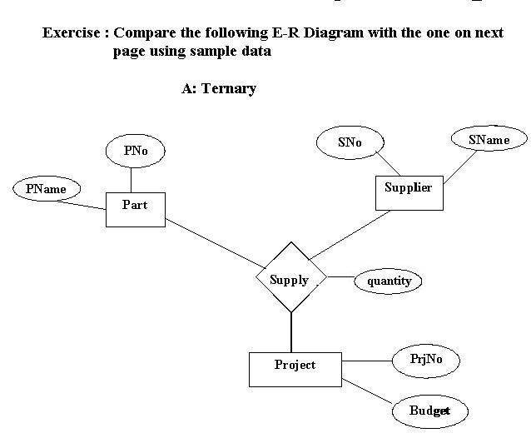

Slide 39
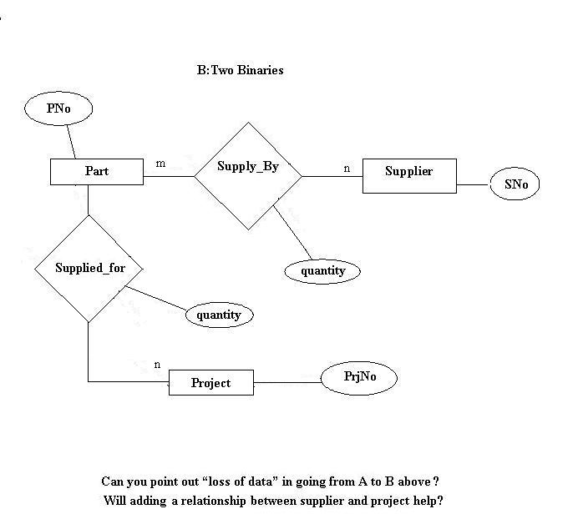

Slide 40
Binary Vs. Non-Binary Relationships
Some relationships that appear to be non-binary may be better represented using binary relationships
E.g., A ternary relationship parents, relating a child to his/her father and mother, is best replaced by two binary relationships, father and mother
Using two binary relationships allows partial information (e.g., only mother being know)
But there are some relationships that are naturally non-binary
Example: proj_guide
Notes:
40

Slide 41
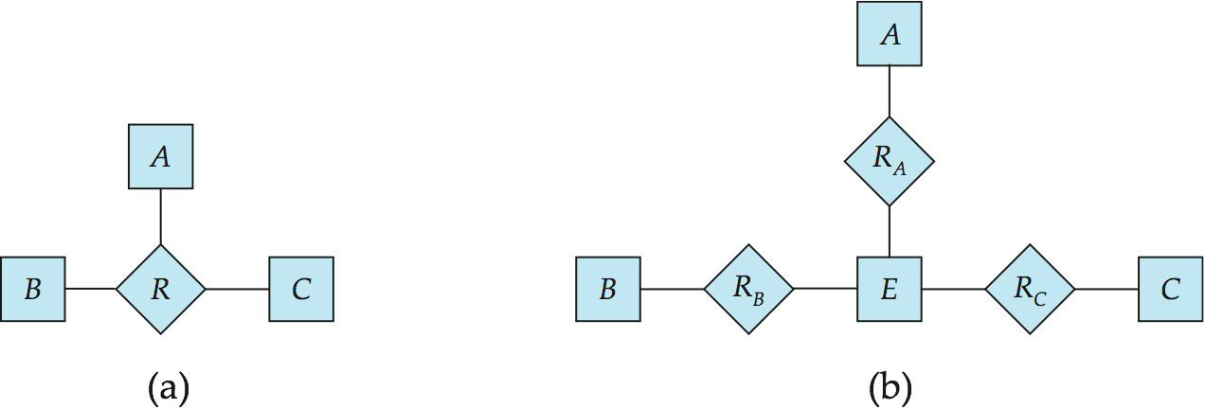
Converting Non-Binary Relationships to Binary Form
In general, any non-binary relationship can be represented using binary relationships by creating an artificial entity set.
Replace R between entity sets A, B and C by an entity set E, and three relationship sets:
1. R_{A}, relating E and A 2. R_{B}, relating E and B 3. R_{C}, relating E and C
Create a special identifying attribute for E
Add any attributes of R to E
For each relationship (a_{i} , b_{i} , c_{i}) in R, create
1. a new entity e_{i} in the entity set E 2. add (e_{i} , a_{i} ) to R_{A}
3. add (e_{i} , b_{i} ) to R_{B} 4. add (e_{i} , c_{i} ) to R_{C}
Notes:
41

Slide 42
Converting Non-Binary Relationships (Cont.)
Also need to translate constraints
Translating all constraints may not be possible
There may be instances in the translated schema that cannot correspond to any instance of R
Exercise: add constraints to the relationships R_{A}, R_{B} and R_{C} to ensure that a newly created entity corresponds to exactly one entity in each of entity sets A, B and C
We can avoid creating an identifying attribute by making E a weak entity set (described shortly) identified by the three relationship sets
Notes:
42

Slide 43
Binary vs. Ternary Relationships
If each policy is owned by just 1 employee, and each dependent is tied to the covering policy, first diagram is inaccurate.
What are the additional constraints in the 2nd diagram?
name
ssn
lot
pname
age
Employees
Covers
Dependents
Bad design
Policies
policyid
cost
name
pname
age
ssn
lot
Dependents
Employees
Purchaser
Beneficiary
Better design
Policies
policyid
cost
Notes:
7

Slide 44
Binary vs. Ternary Relationships
CREATE TABLE Policies (
policyid INTEGER,
cost REAL,
ssn CHAR(11) NOT NULL,
PRIMARY KEY (policyid).
FOREIGN KEY (ssn) REFERENCES Employees,
ON DELETE CASCADE)
The key constraints allow us to combine Purchaser with Policies and Beneficiary with Dependents.
Participation constraints lead to NOT NULL constraints.
CREATE TABLE Dependents (
pname CHAR(20),
age INTEGER,
policyid INTEGER,
PRIMARY KEY (pname, policyid).
FOREIGN KEY (policyid) REFERENCES Policies,
ON DELETE CASCADE)
Notes:
8

